Slide 1

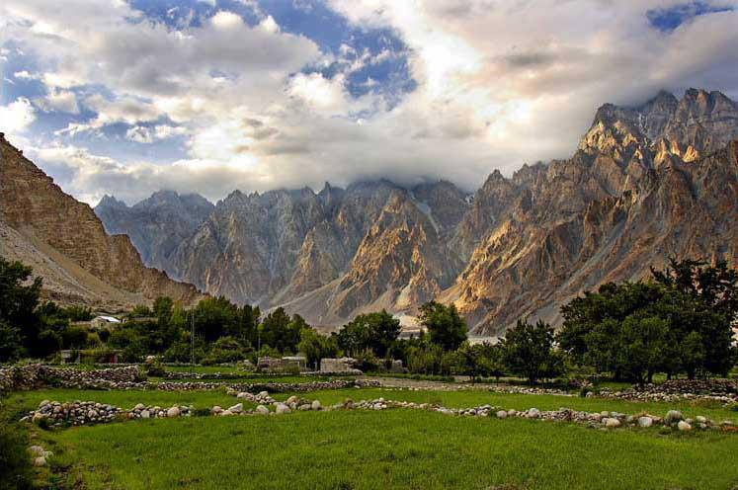


GB Board of Intermediate and Secondary Education

